Slide 1
OAuth2 and authentication standardisation across facilities
Guilherme de Freitas
18th November 2025

Slide 2
Introduction
Make quirks and features of OAuth2 clear
Expose benefits to users and facilities alike
How we use it at Diamond
How it can be applied in different use cases
How it helps with interoperability and reduces workloads
Not a presentation on how to check someone's permission to access data (authorisation) - happy to discuss it later!

Slide 3

Background
Created in 2006
"The" standard for authentication – used by Google, Microsoft, UK gov websites, Amazon, and ourselves
Meant to require no code changes when swapping providers
If you use Keycloak or any modern authentication provider, you may have already implemented it

Slide 4
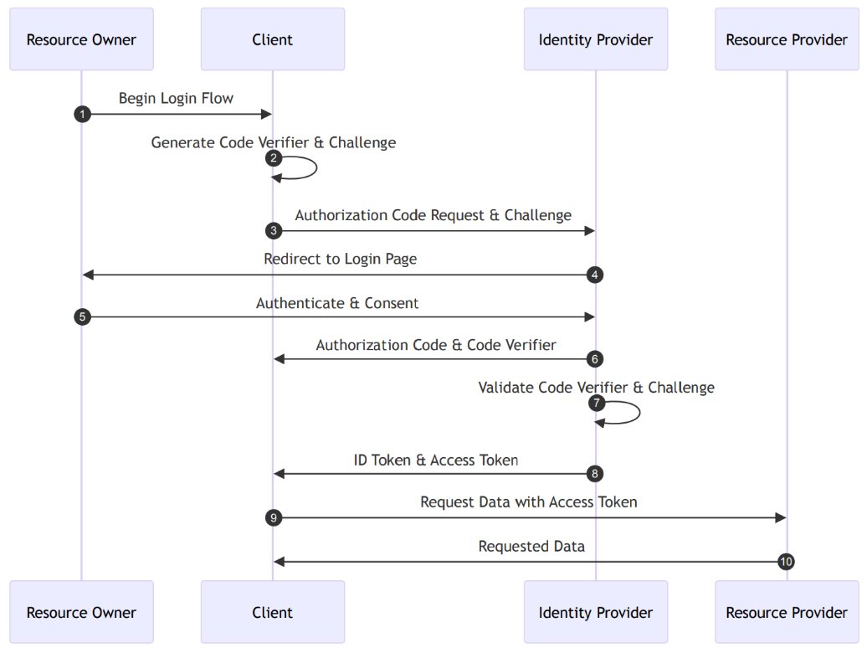
OAuth2 PKCE Flow

Slide 5
Security
Exposes no credentials at any point – user is always redirected to the facility's login page
Implemented at large by most technology companies, and OAuth2-enabled authentication providers are available and have been mature for ages
OAuth2 client libraries exist for most languages
Battle tested (and source of many discussions)
Protections in place for XSS/CSRF attacks
Still needs to be used wisely, and flows need to be chosen carefully
Adheres to rule #1 of cybersecurity: Don't roll your own security

Slide 6

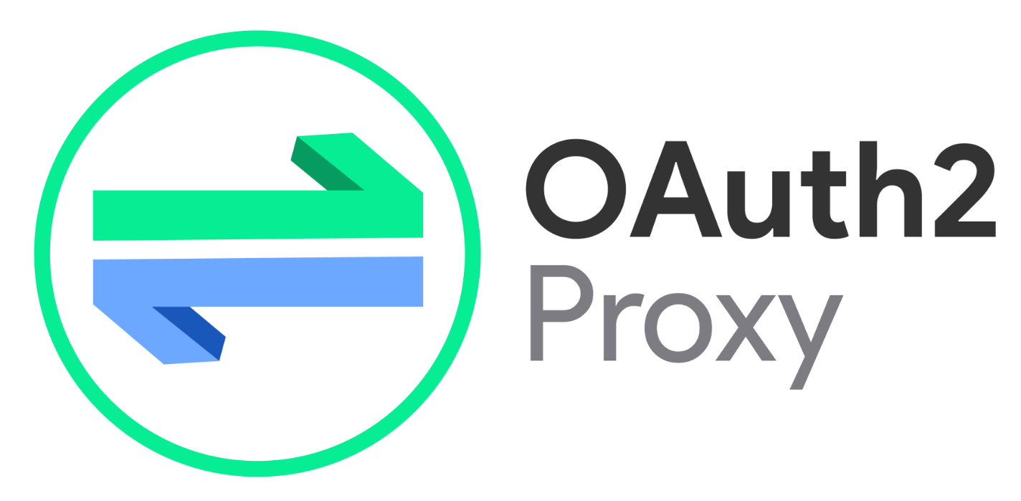
Security
Allows developers to roll out an authentication wall for any web app in minutes – OAuth2 Proxy
Doesn't deal with authorisation, but you can set a list of allowed users
Minimal configuration
Auth Provider
App

Slide 7
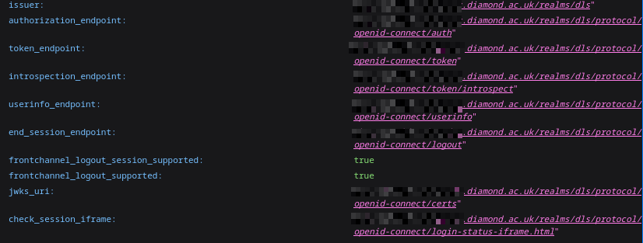
Discoverability
Known endpoint that all OAuth2 providers provide
Lists endpoints, capabilities, fields
Machine-readable
Means that any developer must only configure one URL per facility/service

Slide 8
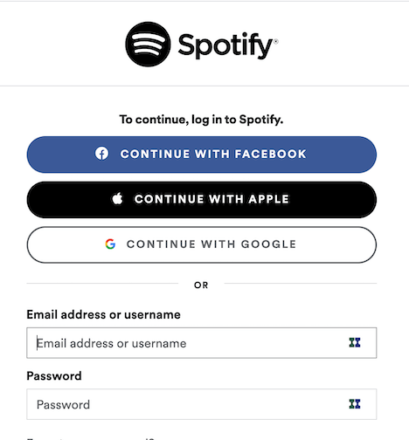
Interoperability
You could login in one facility with another facility's OAuth2 flow
Commonly seen across the web nowadays
Umbrella/ORCID can use OAuth2
Users can very quickly create "portals" to access data through your own authentication mechanisms

Slide 9
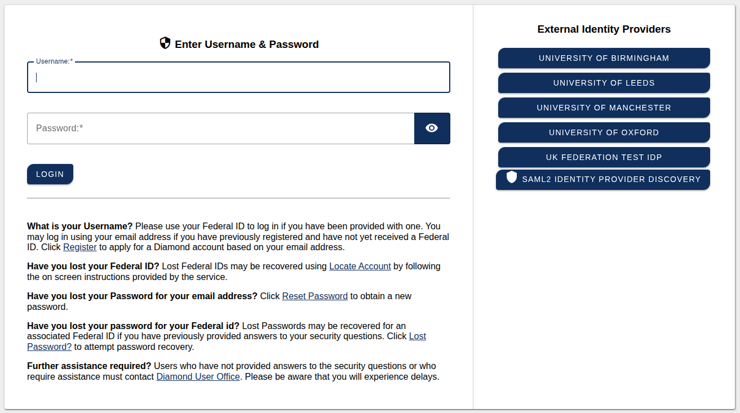
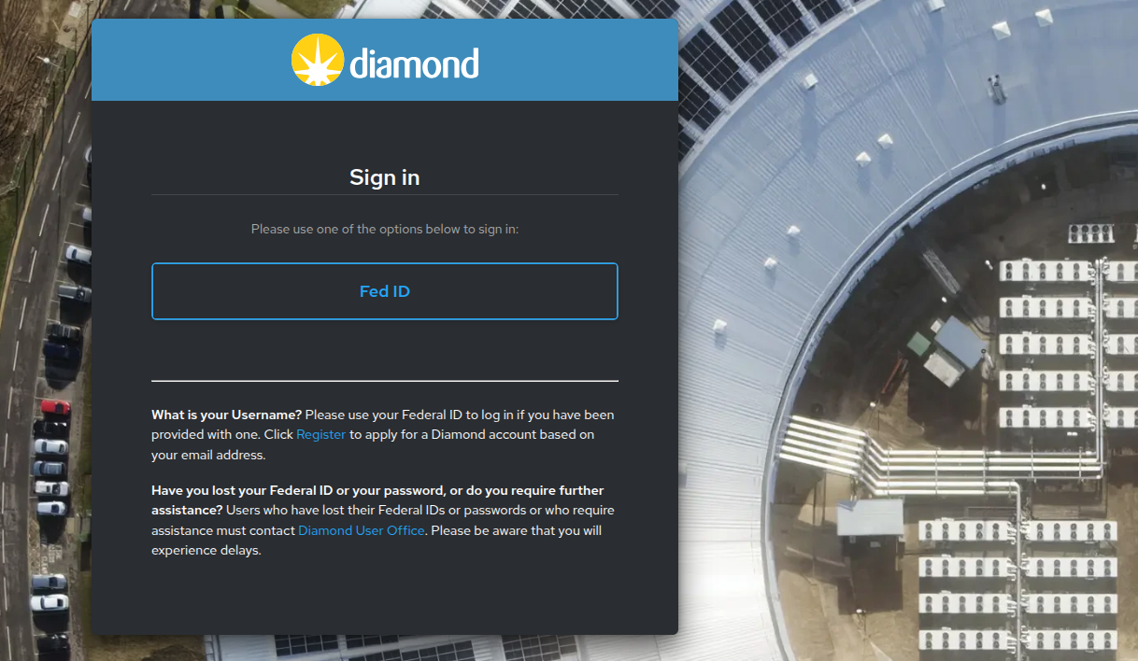
Interoperability
Switching from CAS (the provider) to Keycloak in Diamond was made easy (easier...) because of OAuth2
Operational details of authentication implementation are hidden
Able to "drop in" MFA without making code changes to existing applications

Slide 10
Why?
Free – it's a protocol, not a piece of software, can be implemented in many ways
Your facility may have already implemented it
Makes interaction between facilities easier
Makes API access easier – machine authentication is made simple
Allows you to very quickly add another layer of security to any apps that currently run without authentication
Frees up resources for tasks with more "added value"

Slide 11
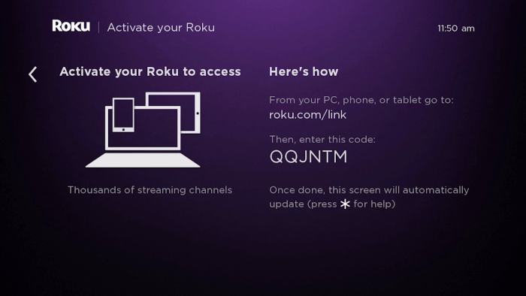
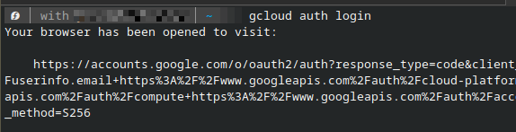
Grant types
Client credentials – ideal for programmatic access in long lived applications that run without human supervision (like sync jobs)
Device authorisation – ideal for situations where input is difficult or impossible (like terminals or TVs)
PKCE code exchange - Meant for users which are directly interacting with a web app

Slide 12
Future consideration
Could be part of a larger discovery endpoint for a facility and its APIs
Tighter collaboration on security, good practices, and more reusability
Greatly simplifies the security aspects of making an API public (whilst following proper security standards)
Still requires some thought about how to convert user IDs, facility-specific user IDs (proposals, dewar IDs, etc.) - AuthZ
Standardisation between facilities on AuthN might be closer than imagined

Slide 13
Further reading
https://alexbilbie.github.io/guide-to-oauth-2-grants/ - How to choose a flow/grant type
https://www.oauth.com/playground/ - Interactively test out grants and flows
https://datatracker.ietf.org/doc/html/rfc6749 - Full OAuth2 RFC
https://www.keycloak.org/ - Keycloak
https://developer.mozilla.org/en-US/docs/Web/Security/Practical_implementation_guides - HTTP security implentation guides

Slide 14
Thank you! guilherme.de-freitas@diamond.ac.uk

